Slide 1
Capstone Project - The Battle of Neighborhoods
Jawharah Almulhim 11 June -2020

Slide 2
Background
New York it is one of the largest city on USA with huge number of population and diversity of people.
The NYC is a main distance for visitors from all over the world .
The idea of this project is to explore Manhattan and suggest a Higley rated parks on Manhattan
Ending up with clustering different parks of Manhattan into different clusters with similar features.

Slide 3
Data acquisition and cleaning
New York City data that contains list Boroughs, Neighborhoods along with their latitude and longitude. Data source : https://cocl.us/new_york_dataset
Foursquare API service: using API calls to get neighborhoods and venues of the selected borough as well as detailed information about venues such as tips, likes, rating and more. Such information is necessary for clustering.
Pandas data frames is used to store the results of the API calls and do the operations
Geopy is client which is used to locate the coordinates of addresses using third-party geocoders
K-mean clustering :machine learning tool to cluster the parks on different cluster based on similarities

Slide 4
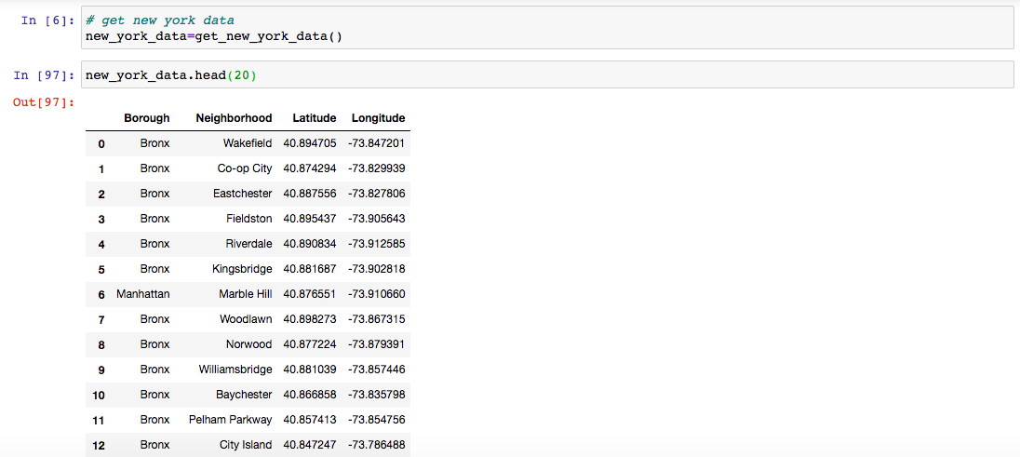
Data Analysis
New York data:

Slide 5
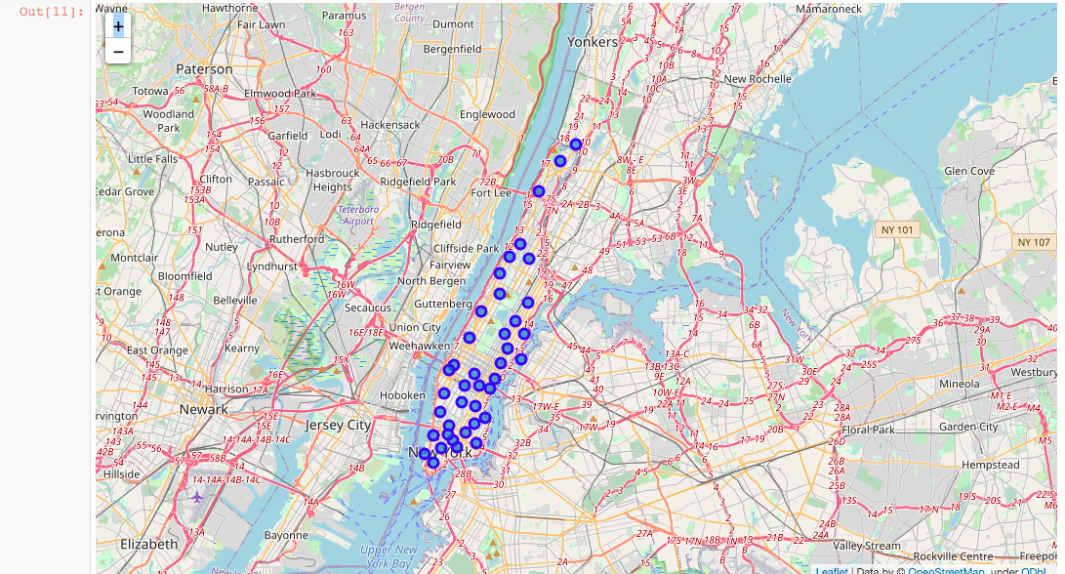
Data Analysis
Map of New York city:

Slide 6
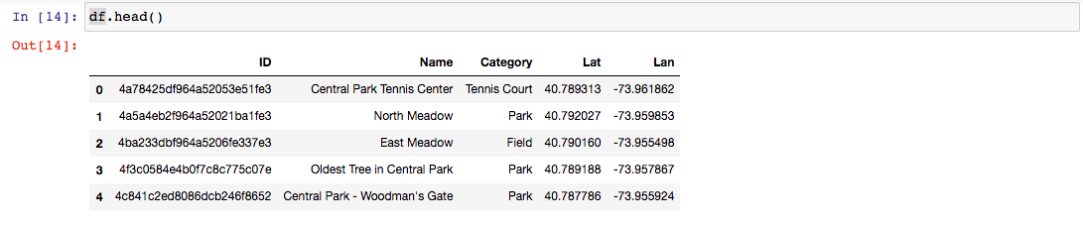
Data Analysis
Venues of Manhattan

Slide 7
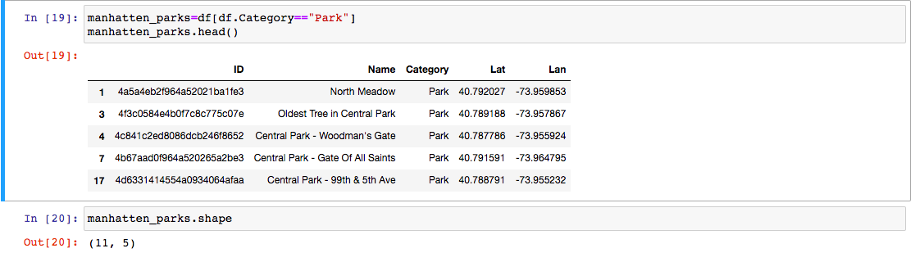
Data Analysis
Manhattan Parks:

Slide 8
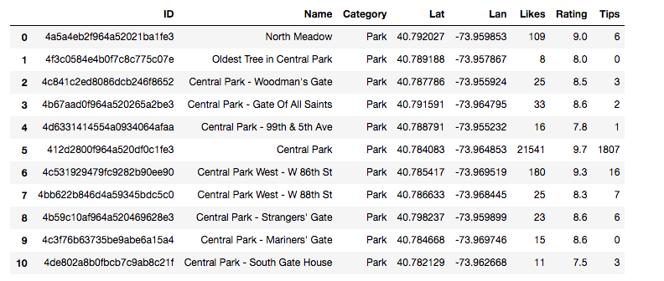
Data Analysis
Manhattan Parks details:

Slide 9
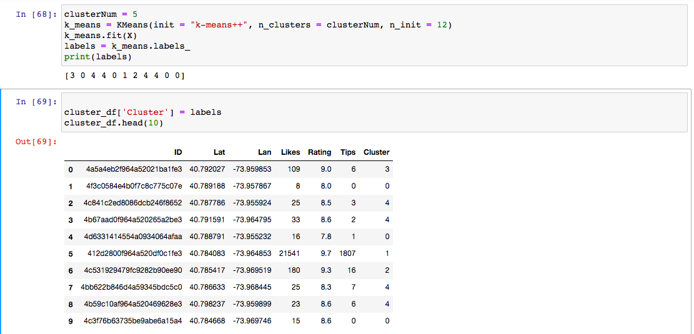
Data Analysis
Result of clustering parks:

Slide 10
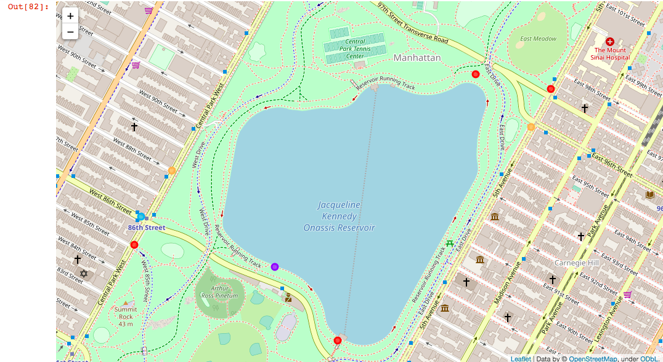
Data Analysis
Map of clustered parks:

Slide 11
Result & Discussion
From the analysis , we notice the following :
parks are the most frequent type of venues on Manhattan.
Central Park is the best park on Manhattan which located on Harlem. Neighborhood
From the clustering , we notice that :
Central park is the only one on its cluster
Recommendation for government agency is to open a similar park on other neighborhood with low rated parks.

Slide 12
Conclusion
In conclusion, this presentation summarize the project on examining Manhattan neighborhoods and clustering its highly frequent venues which are parks.
The result of this project would be useful for NYC-Manhattan visitors and government when they plan to open a new park on Manhattan.

Slide 13
Thank you

